Slide 1
United kingdom
Advanced Democracy

Slide 2
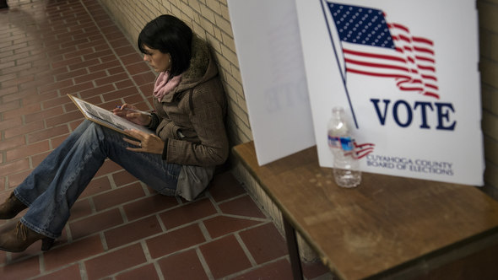
Advanced democracies Political Dimensions
Qualities of Advanced Democracies
Civil Liberties-Freedom of speech, belief, assembly
Rule of Law-Equal treatment of citizens and due process
Neutrality of Judiciary-Other checks on abuses of power
Open Civil Society- citizens can lead private lives and mass media operate independently of government.
Civilian Control of Military-Restricts likelihood of military seizing control of government.
Advanced democracies tend to have high degree of legitimacy.

Slide 3
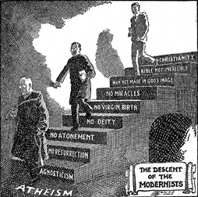
Advanced Democracies Economic Dimensions
Political culture of advanced democracies reflect post-modernism.
Modernism-Set of values that come along with industrialization
Secularism-Emphasis on non-religious aspect of life
Reasoning-Rationalism
Materialism- Valuing concrete objects and possessions
Technology
Bureaucracy
Emphasis on freedom rather than collective equality

Slide 4
Economic Dimensions
In other words, emphasizes making money and gaining economic success.
Also shift to Post-Modernism-a set of values that emphasizes quality of life over concern with material gain.
Values of Post-Modernism
Preservation of the environment
Promotion of health-care
Education
Also shows shift to post-industrialism where most people are employed in the service sector.

Slide 5
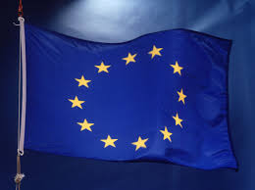
Supranational Organizations: The European Union and NAFTA
Western Europe had a need to integrate after WWII
Why?
NAFTA
Created in 1995 as a free trade area
Binds the US, Canada, and Mexico
How is this different from the EU?

Slide 6
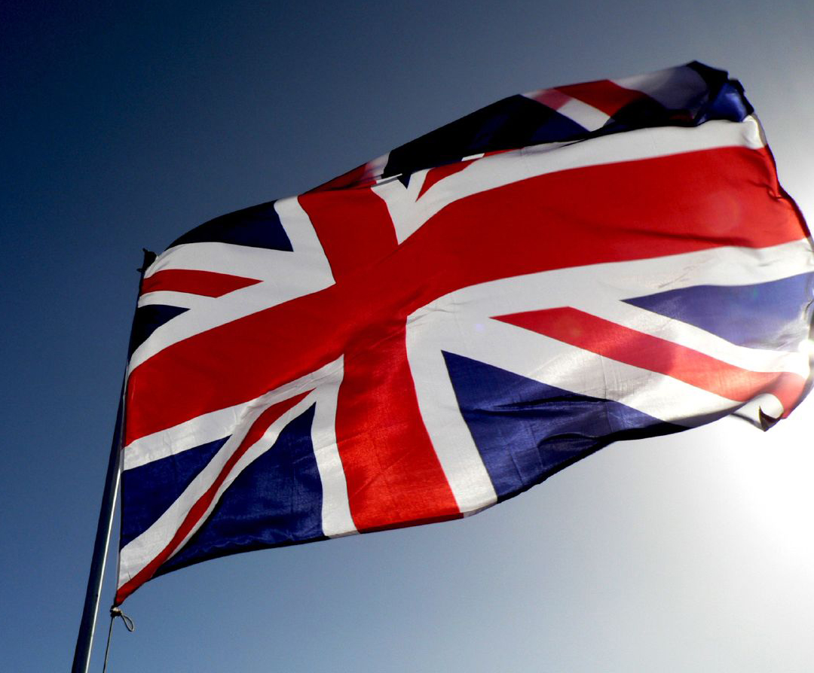
Government and politics in Britain
Great Britain or Little England?
“The Little island that conquered the world!”
Has three major sources of authority and power that provide stability and legitimacy
Social compacts and Constitutionalism
Historical Evolution of National Political Traditions

Slide 7
Sovereignty, Authority, and Power Social Compacts and Constitutionalism
Tradition is Britain’s primary source of legitimacy.
For many years it was based on traditional legitimacy-hereditary ruling family had the right to rule.
Most accept a church/state relationship.
Even though it has had such on impact on democracies, it has never had a written constitution.
“Constitution of the Crown”-Combination of important documents, common law,and customs.
Limitation of king’s power began in the Middle Ages
Magna Carta
Bill of Rights
Common Law

Slide 8
Sovereignty, Authority, and Power Historical Evolution of National Political Traditions
Mostly influenced from the traditions of their long history.
The Shaping of a Monarchy- Created in Middle Ages. Had check on power in 1215. In 1640s, Charles I beheaded and Oliver Cromwell ruled but brought back monarchy (monarchy restoration). Today has no decision making power.
The ascendancy of Parliament- English Civil War in 1640s battle between parliament/Oliver Cromwell (Roundheads) and monarchy. William and Mary in 1688 signed Bill of Rights to limit power of crown. Power of prime minister established in 18th cent. By Robert Walpole, minister to Kings George I and George II.
Challenges of the Industrial Revolution- In 18th century established England as key economic power. Changed feudal relationships between lords and peasants. Gave rise to a merchant class who demanded say in government.

Slide 9
Historical evolution (cont)
Colonialism- Between 1750 to 1914 nationalism and industrialization made it possible for European nations to build global empires.
Power started to decline with loss of American colonies-increased in 19th century with Asia and Africa-but then declined again.
Britain in the 20th and early 21st centuries- Start of 20th century Britain greatest imperialist nation in world. Then started to decline. Became strong welfare state after WWII but then declined with Thatcherism- conservative, capitalist backlash led by Prime Minister Margaret Thatcher.
Tony Blair described a “third way”
Beat by Gordon Brown who then lost in 2010.

Slide 10
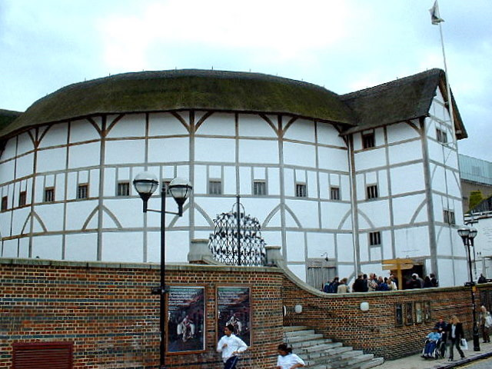
Sovereignty, Authority, and Power Political culture
“This fortress built by Nature for herself
Against infection and the hand of war
This happy breed of men, this little world,
This precious stone set in the silver sea,
Which serves it in the office of a wall,
Or as a moat defensive to a house,
Against the envy of less happier lands;
This blessed plot, this earth, this realm, this England.”
Richard II
William Shakespeare

Slide 11
Sovereignty, authority, and power Political Culture
Geographic Features
Small island-far enough away from mainland Europe to protect her. Good navy. Also promotes insularity-feeling of separation.
Small Size-Resources limited which led to colonization
Short supply of fertile soil/short growing season-Ability to feed population limited.
Temperate climate but cold, chilly, and rainy-Population density one of highest in world, but lots lower in Northern areas
No major geographical barriers- No mountains, deserts, or raging rivers hamper communication within the country.

Slide 12
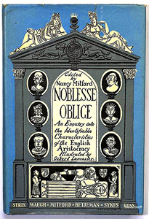
Sovereignty, Authority, and Power Other characteristics of political culture
Noblesse oblige-The duty of the upper classes to take responsibility for the welfare of the lower classes.
Where would this come from?
Shown in a willingness to accept a “welfare state”-except with Margaret Thatcher.

Slide 13
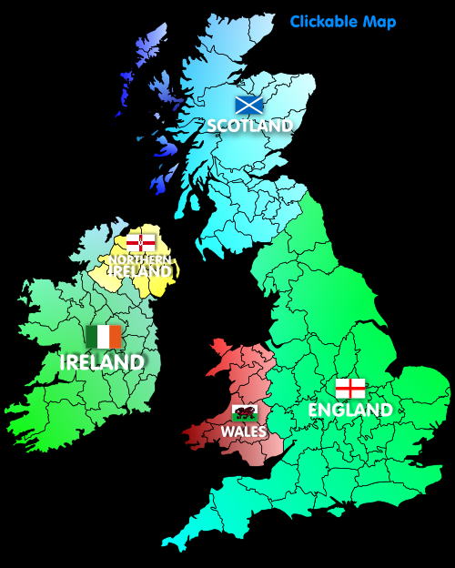
Sovereignty, authority, and power Other Characteristics of Political culture
Multi-nationalism-
Countries that make up the UK are……
All have different dialects, histories, religions
Overall English have willingness to obey the laws which show high level of legitimacy.

Slide 14
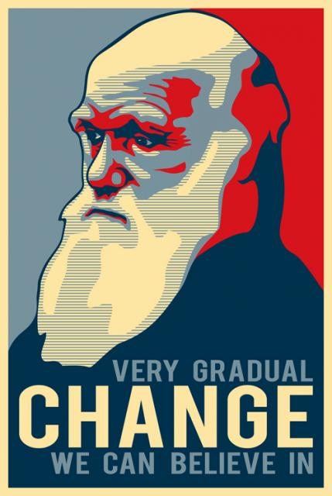
Political and economic change
Political change in UK has always been by gradual nature.
Explains transition from king to parliament with William II consulting lords before taxing them.
Changes through evolution not revolution!

Slide 15
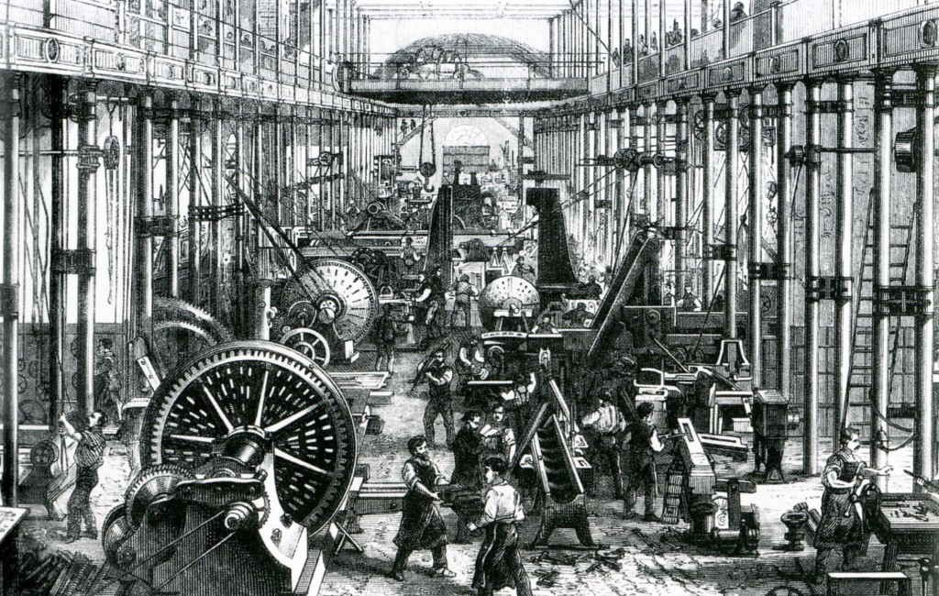
Political and economic change adjusting to the industrial revolution
Industrial Revolution created new middle class that wasn’t accounted for in Parliament.
Extension of Voting Rights and Work and Welfare Reforms
Meant that Marxism would not take root. Why?

Slide 16
Political and Economic Change Political effects of the extension of rights to common man
By 1911 House of Lords only left with power to delay legislation.
Labour Party-created in 1906 to represent the rights of the newly-enfranchised working man
(Conservative Party drew most members from middle-class merchants and businessmen.)
Labour party pushed for welfare measures, education, housing, jobs, medical care. Pushed the liberals into 3rd place where they have stayed.
Labour party pushed for welfare changes.

Slide 17
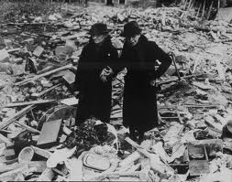
Political and economic change Reacting to the loss of imperialist powers
WWII brought widespread damage to England.
Had to step aside to make place for US and USSR

Slide 18
Political and economic change collective consensus
Winston Churchill during WWII emphasized putting away class struggle to win the war.
Started coalition government that continued under collective consensus into 1960s to support modern welfare system.
Beveridge Report- provided for social insurance program that made all citizens eligible for health, unemployment, pension, and other benefits.
National Health Service in 1948.
Laid grounds for mixed economy- Government directing the economy and nationalizing major industries without giving up basic principles of capitalism (private ownership)

Slide 19
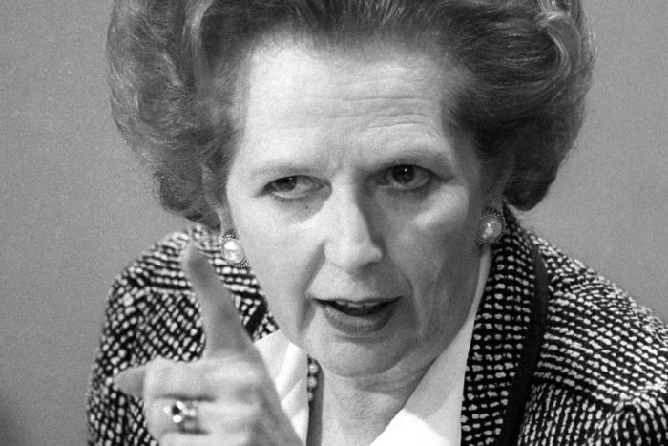
Political and economic change Challenge to collective consensus since 1970s
Economic crisis of the 1970s
Declining industrial production and international influence
Exaggerated by loss of colonies
OPEC quadrupled oil prices
High unemployment
Led labour unions to demand higher wages
This led many people to turn to conservative party-Margaret Thatcher in 1979

Slide 20
Political and economic change thatcherism
Thatcher blamed weakened economy on socialist policies set by gov after WWII.
Privatized business, cut back welfare, upped national defense, tough on labor unions, market force of economy.
Reflects neo-liberalism-revival of liberal values that support low levels of government regulation, taxation, and social expenditures and the protection of individual property rights.
Called Iron Lady
Policies re-directed Britain’s path from welfare state.

Slide 21
Tony Blair’s third way
John Major-Thatcher’s successor who at first followed her policies.
1997 Labour gradually returned to center with Tony Blair and “third way”-centrist alternative to Labour Party on left and Conservative Party on right.
Blair hurt by Iraq war and stepped down in 2007-replaced by Gordon Brown.
Tried to convince people to stay loyal to Labor Party but 2008 recession hurt Brown.
In 2010 defeated but Conservatives could not get majority. Had to make coalition between Conservatives and Liberal Democrats-led by David Cameron.

Slide 22
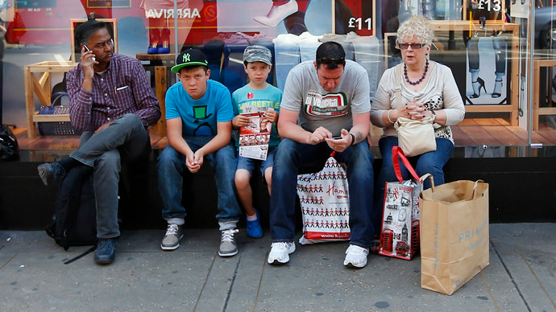
Citizens, Society, and the State
Overall homogenous culture.
English spoken by virtually all citizens
Only 5% of 60 million are ethnic minorities.
Social Cleavages
Have longtime been based on social class distinctions
Protestant/Catholic split in Northern Ireland
Now minority Muslims increasing

Slide 23
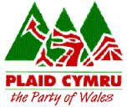
Citizens, Society, and the State Multi-national identities
England
Has majority population
Have typically dominated other nationalities-Trying to integrate other nationalities but allowing them to keep identity.
Wales
West of England-became subject in 16th century
` Plaid Cymru- Flag of Wales
Welsh taught in schools
Some resentment over English culture

Slide 24
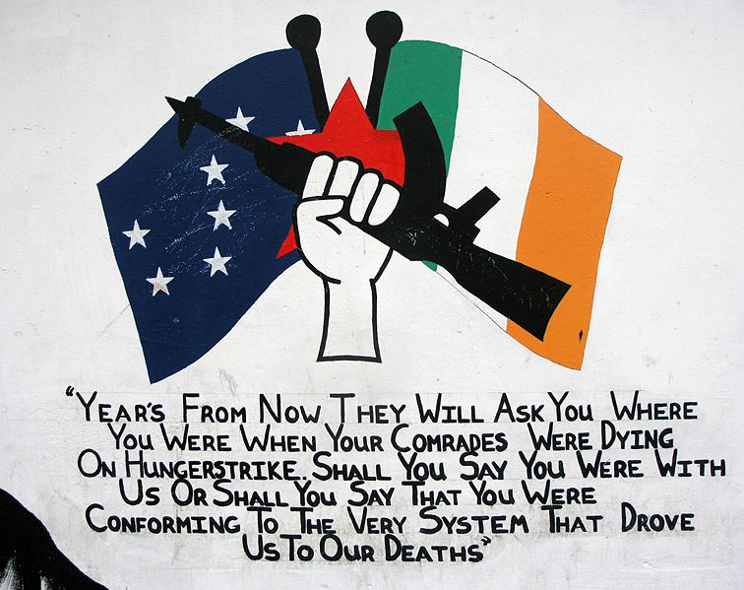
Citizens, Society, and the state Multi-national identities
Scotland
Joined in 1600s through intermarriage, James I King of Scotland (Queen Elizabeth I died without heir-went to nephew)
Have their own flag
Have their own parliament
Northern Ireland
Strong history of conflict over Protestant/Catholic
Home rule- after WWII
Not given to Northern Ireland where Protestants outnumber Catholics 60% to 40%
Lots of militant work from IRA
In 1949 most of Ireland given full freedom

Slide 25
Citizens, society, and the state Social class distinctions
Distinction between working and middle class.
There is an idea of solidarity- that keeping the old job and living in the old neighborhood-sense of family and friends-is more important than individual success.
Reinforced in “Public Schools” originally meant for boys who wanted to “public life”
Middle class students go to private grammar schools.
Only 65% of British seventeen year old boys are still in school-lowest level in any industrialized democracy.- Just raised from 16 to 18 in 2013
Most important portal to elite class is through Oxford or Cambridge Universities or Oxbridge.
More public universities now open.

Slide 26
Citizens, Society, and the state Ethnic minorities
7.1 % of population is of non-British origin. Ethnic population grew 53% between 1991-2001.
Indian-23% of non-European
Packistani-16%
Afro-Caribbean-12.2%
Black African-10.5%
About half of the population is under 25 because of tighter restrictions in past.
Muslims-under great deal of pressure in recent years. Reports of unequal treatment of minorities.

Slide 27
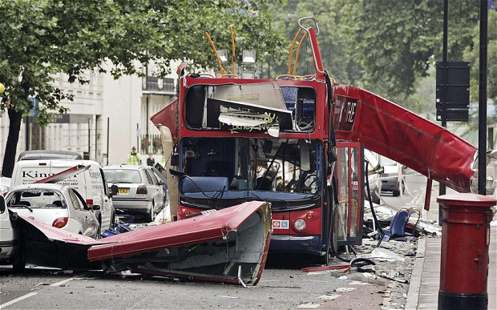
Citizens, society, and the state Muslim Minorities
Britain’s risk for terrorist attacks great than others because…
Distinct minority/ethnic cleavages
Social class differences of Muslims
Pakistani Muslims
Opposition to Iraq War
Lack of integration of minorities
Also have a lot of immigrants coming from Eastern Europe –Especially Poles.

Slide 28
Citizens, society, and the state Political beliefs and values
Changes in 1970s meant that Brits less supportive of collective consensus and more supportive of values with free market economy.
Politics of Protest has become increasingly supported.
Some manifestations of changing political beliefs
Decreasing support for labor unions-
Increased violence in Northern Ireland-
Thatcherism- Conservatives ruled from 1979-1997.
New Labour-New Way headed into 21st century.
Protests over Iraq War

Slide 29
Citizens, Society, and the state Voting behavior
More than 70% of eligible voters typically vote in parliamentary elections.
Social Class
Until WWII, voting followed class lines.
Working class voted labour, middle class voted conservative.
Today lines are blurred because parties and society has changed.
Many have turned to voting liberal democrat.
Regional Factors
Labour Party does well in urban and industrial areas in Scotland and Wales, North England and central London
Conservatives win in rural and suburban areas.
Tied to social class and urban vs. rural values.

Slide 30
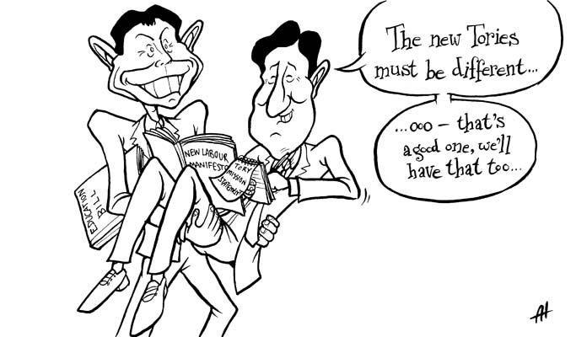
Political institutions
Political Parties
Whigs-Liberal Party (Opposed Charles II)
Tories- Conservatives (Supported Charles II)
Major parties today are Labour party and Conservative party.
Traditionally have had strong third parties. Typically liberal democrats.
Use parliamentary system with “first past the post” system.

Slide 31
Political institutions linkage institutions
Political parties, interest groups, print and electronic media.
Political Parties
Parties started in 18th century.
At first just caucuses-Meeting of likeminded people
Labour party came after Industrial Revolution.
2010 parliament unusual because no party gained majority, and coalition government formed.

Slide 32
Political institutions Labour party
Largest party on left.
Controlled government since 1997 until 2010 when ceded power to coalition.
Labor unions have provided the most funds.
Early history of party called for Clause 4-Controversial call for nationalization of “commanding heights” of British industry. Removed in 1990s.
Has had a general move towards center with Neil Kinnock, John Smith, Tony Blair, Ed Miliband (2010-present).

Slide 33
Political institutions The conservative party
Dominant party between WWII and 1997.
Supported market-controlled economy, privatization, less welfare.
Very conservative under Thatcher, but moved back to center with John Major (1990-1997)
After Labour took over in 1997-Weakened by divisions between two groups-
Traditional Wing(one=nation Tories)- Elite class that takes everyone’s interest into account before making decision.
The Thatcherite wing- More conservative and want to roll back government controls of economy. Don’t like European Union move-Euroskeptics
Current leader is David Cameron- Nick Clegg (Liberal Democrat) deputy prime minister.

Slide 34
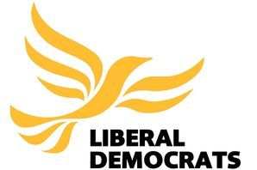
Political institutions The liberal democrats
Established in 1989 (Merger between Liberals and Social Democrats)
Promised to find liberal grounds between Thatcher’s extremely conservative leadership and Labour’s leftist views and strategies.
Won 26% of votes in 1983 but because of Single Member District Plurality only 23 seats.
Brits have campaigned for proportional representation and Bill of Rights.
Have declined in early 1990s. Helped when Nick Clegg named deputy prime minister.

Slide 35
Political institutions Other parties
Have nationalist groups from other countries
Plaid Cymru (Wales)
Scottish National Party
Sinn Fein (political arm of IRA)
Democratic unionist party (Protestant clergymen in Ireland)
British National Party (Never represented in Parliament) Considered racist.
UK Independence Party (Opposition to British membership in EU.)

Slide 36
Political institutions Elections
Plurality Electoral System
Have a winner-take-all system like US (About 65,000 per district)-650 districts
MPs do not have to live in district they represent-so party leaders run from safe districts where that party almost always wins
This winner-take-all system often exaggerates victory or larger party and reduced influence of minor parties.
Elections held every 5 years.

Slide 37
Political institutions Interest groups
Interest Group Pluralism-autonomous groups competing with one another for influence in policy making
Neo-corporatism-Where interest groups take the lead and sometimes dominate the state
Quangos-quasi-autonomous nongovernmental organizations-policy advisory boards appointed by the governor.
Trade Unions Congress-Coalition of unions with a great deal of clout because government often consults them. Slammed shut by Thatcher. Gaining more power in 1990s.

Slide 38
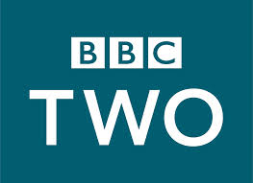
Political institutions the role of the media
British newspapers reflect social class divisions.
Radio and television came during collective consensus era so originally controlled by BBC.
Commercial television introduced in 1950s and now have 5 stations that compete.
Somewhat strictly regulated by the government.
No advertisements may be sold to politicians, parties, or political causes.

Slide 39
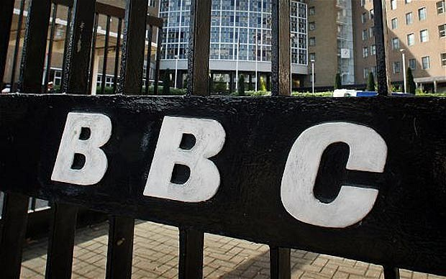
Political institutions BBC and government restrictions
Big clash with Blair government in 2003 with Iraq war.
Labour government continued to support BBC with liscense fee on any household in Britain with a television that receives broadcasts.
Conservatives have wanted a more transparent BBC

Slide 40
Political institutions media scandal of 2011
News of the World in 2011 with phone hacking. Brought down Rupert Murdock.
Brought relationship between media and politics into question-political favoritism and coziness.
Press regulation at the forefront of Cameron’s coalition government.

Slide 41
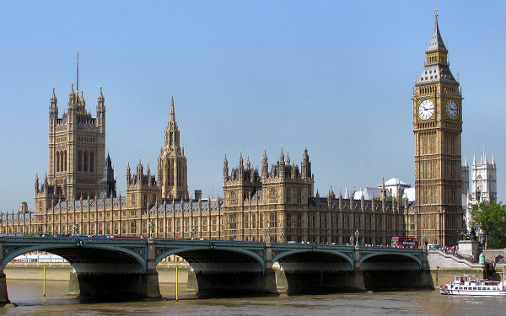
Political institutions the institutions of national government
British government has 3 branches and a bureaucracy.
Has a bicameral legislature but a parliamentary system. Separation of powers does not exist.
Britain is a unitary state with power centered in London.

Slide 42
Political institutions the cabinet and the prime minister
Unlike US cabinet, in Britain the cabinet leaders are members of parliament.
Collective cabinet center of policymaking in Britain. Do not vote but publically support the prime minister.
Prime minister is “first among equals”.
Since no majority party emerged, formed conservatives formed coalition with liberal democrat leader Nick Clegg. Had to compromise and adjust viewpoints.

Slide 43
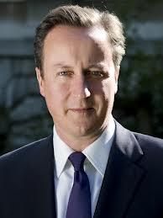
Political institutions the cabinet and the prime minister
The prime minister
Speaks for all members of Parliament.
Chooses cabinet ministers and other subordinate posts.
Makes decisions in the cabinet with agreement of the ministers.
Campaigns for and represents the party in parliamentary elections.

Slide 44
Political institutions parliament
The House of Commons
Assumed that one party will get majority and another party with be opposition.
Majority party vs. “loyal opposition”
Setup of House of Commons
Two benches facing one another with a table in the middle “two sword lengths wide”
Prime minister sits on the front bench of majority side in the middle. Across is leader of opposition party.
Cabinet members on front rows of majority side and “shadow cabinet” faces them on opposition side.
Back benchers are less influential MPs.

Slide 45
Political institutions parliament
Debate
Have a once a week Question time where members of parliament and cabinet must defend themselves and their decisions.
Speaker of the House presides over debate.
This is where MPs get noticed for future leader spots and also the primary “check” on power since checks and balances do not exist.
Party Discipline
Since majority is the government, if party members do not support leadership, government may fall into crisis.
If there is a vote of no confidence then cabinet must resign immediately.
Backbenchers have been more outspoken than in the past.
Had parliamentary expenses scandal in 2011 that questioned parliamentary sovereignty

Slide 46
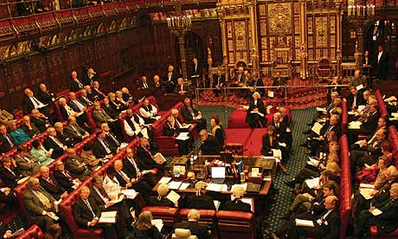
Political institutions House of lords
House of Lords has very little power.
The only hereditary parliamentary house in existence today.
The only power today is to delay legislation and to debate technicalities of proposed bills.
Can add amendments to bills but will get overturned with majority vote in Commons.
Until 1999 half were hereditary peers and half were life peers. The government then took most hereditary peer seats away.

Slide 47
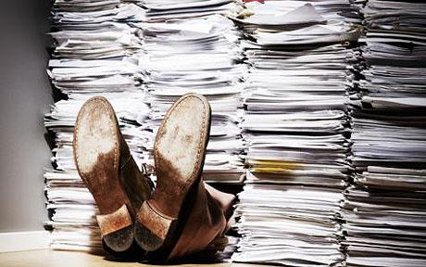
Political institutions bureaucracy
Britain has a highly advanced bureaucracy.
Top civil servants have great deal of input in policymaking including discretionary power to make many decisions in implementing legislative and executive decisions.
Bureaucrats typically do not run for office but stay and fulfill important role in government.

Slide 48
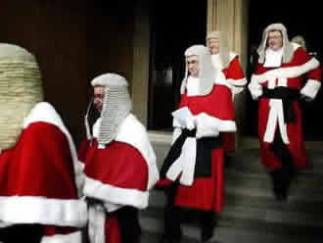
Political institutions the judiciary
The idea of trial by jury goes back to Henry II in 13th century. But now much more limited power.
Parliamentary sovereignty has limited judicial power.
British courts can only say whether government decisions violate common law or previous acts of parliament. Courts cannot impose rulings on Parliament, prime minister, or cabinet.

Slide 49
Political institutions the judiciary
British legal system based on common law as opposed to code law in rest of Europe.
In 2009 a Supreme Court was created to replace law lords.
The court has a president and 11 justices appointed by a panel of lawyers.
It cannot declare an Act of Parliament unconstitutional.
Appointed on “good behavior” but expected to retire at 75.
Now judges have responsibility of reviewing EU laws and determine whether they conflict with parliamentary statutes.

Slide 50
Public policy and current issues
In 2010 formed coalition government of Conservatives and Liberal Democrats-only second since WWII.
Evolving Relationship between the Government and the Economy
Historical basis of economy is liberalism-political and economic freedoms.
Since end of WWII redefined relationship with economy several times.
Until 1970s, collective consensus based on belief of strong democratic values with government in economy and nationalizing industries. (Keynesianism)
Margaret Thatcher then emphasized neoliberalism-return to liberalism that had once held Britain.
Since then they have tried to search for more middle ground.

Slide 51
Public policy and current issues
The Evolving Relationship between Government and the Economy
Blair teamed up with Gordon Brown to bring down “misery index” inflation plus unemployment to a new low. 2007 declines started to hurt economy.
Gordon Brown emphasized Big Society with greater roles for private companies, charities, and employee owned cooperatives. Said that government had gotten too big and wanted to give more power to citizens.
Liberal Democrats have agreed with Cameron-had drastic reductions in public spending.
Voted to increase maximum fees that a university can charge from $5,400 to $14,500.

Slide 52
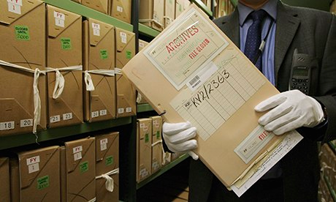
Public policy and current issues
Transparency in the Government
Has a solid reputation of being transparent which is why 2009 scandal was very shocking.
Had “second-homes allowance” and Michael Martin, House of Commons speaker, resigned after claiming thousands of pounds for chauffeured car.
Lowered people’s faith in government.
Fact that they were exposed still shows that transparency is high.

Slide 53
Public policy and current issues
Relations with European Union
British insularity has meant that England tends to keep allies at an arm’s length.
Under PM John Major, Britain signed Maastricht Treat which created European Union then more favorable under Blair.
Blair pushed for adoption of Euro but never passed, and Conservative Party is still split.
Recent polls show percentage of citizens who still want pound is below 50%.
David Cameron caught between indecisive Conservative Party.
Many people voted in 2009 with UK Independence Party.

Slide 54
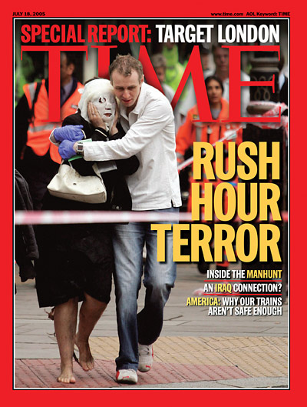
Public Policy and Current Issues
Terrorism and Violence
Four British Muslim suicide bombers attacked transit system in July 2005, killing 52 people.
Government is now earmarking money for terrorism.
Pilot program to teach nonviolence in some Muslim religious classes.-Very controversial.

Slide 55
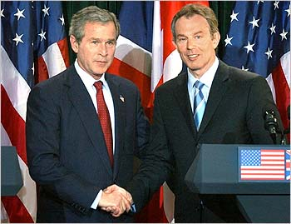
Public policy and current issues
Relationship with the US
Tony Blair sought to keep and build close relationship with US.
Torn with Iraq War which most of Europe opposed.
Since 2008 election of Obama relationships have improved.

Slide 56
Public policy and current issues
Devolution and Constitutional Reform
Which British government is still unitary, continuing desire from Scots, Welsh, and Northern Ireland has made strong push for devolution.
Since 1999 there has been Scottish and Welsh regional assemblies that can tax, and have education and economic planning.
1998 Good Friday Agreement set up parliament for northern Ireland. (closed until 2007 due to violence)

