Slide 1
Communist and Post-Communist Countries
Russia

Slide 3
Communist and Post-Communist Countries
Industrialized democracies have been criticized for the economic inequality.
There is also a big divide in the wealth and power between them.
Communist countries all claim to have roots in Marxism.

Slide 4
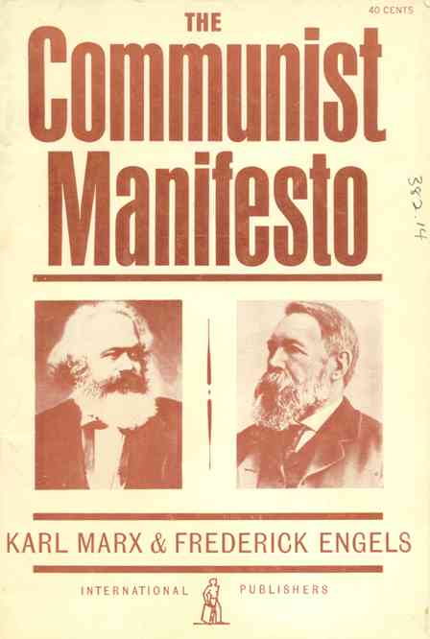
Marxism
Karl Marx, known as the “father of communism”, first wrote down beliefs in The Communist Manifesto in 1848.
Said capitalism exploited workers and made gap between rich and poor.
Workers (proletariat) would eventually join together and overcome the owners (bourgeoisie)
Social class would disappear and private ownership would be banned.
Communism encourages equality and cooperation, without property to encourage greed, government would become unnecessary.

Slide 5
Marxism vs. Leninism
Marx said would first take place in industrialized country.
Lenin asserted importance of vanguard of the revolution-group of rev. leaders who would provoke a revolution in non-capitalist Russia
Democratic Centralism turns into authoritarianism
Served as a model for other revolutions where power rests with the few in the Communist Party.
Rely on co-option-allocation of power throughout various political, social, and economic institutions.
Nomenklatura- filling positions with people approved by communist party.
Does allow for a small amount of social mobility-ability to change social status.

Slide 6
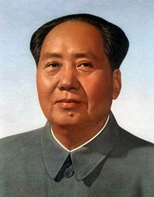
Marxism vs. Maoism
China’s communist leader Mao Zedong
Mao believed in vision of equality and cooperation but wanted to preserve peasant-based society.
Strengthened agriculturally-based communities
After death, Deng Xiaoping instituted market-based socialism.

Slide 7
Communist Political Economy
Communist ideology led to political economies characterized by central planning-ownership of private property and market mechanism replaced with allocation of resources by the state bureacracy.
Have experienced problems of
Logistical difficulties-Planning entire economy is difficult.
Lack of worker incentives- workers don’t worry about losing their jobs, factories won’t go out of business, etc…

Slide 8
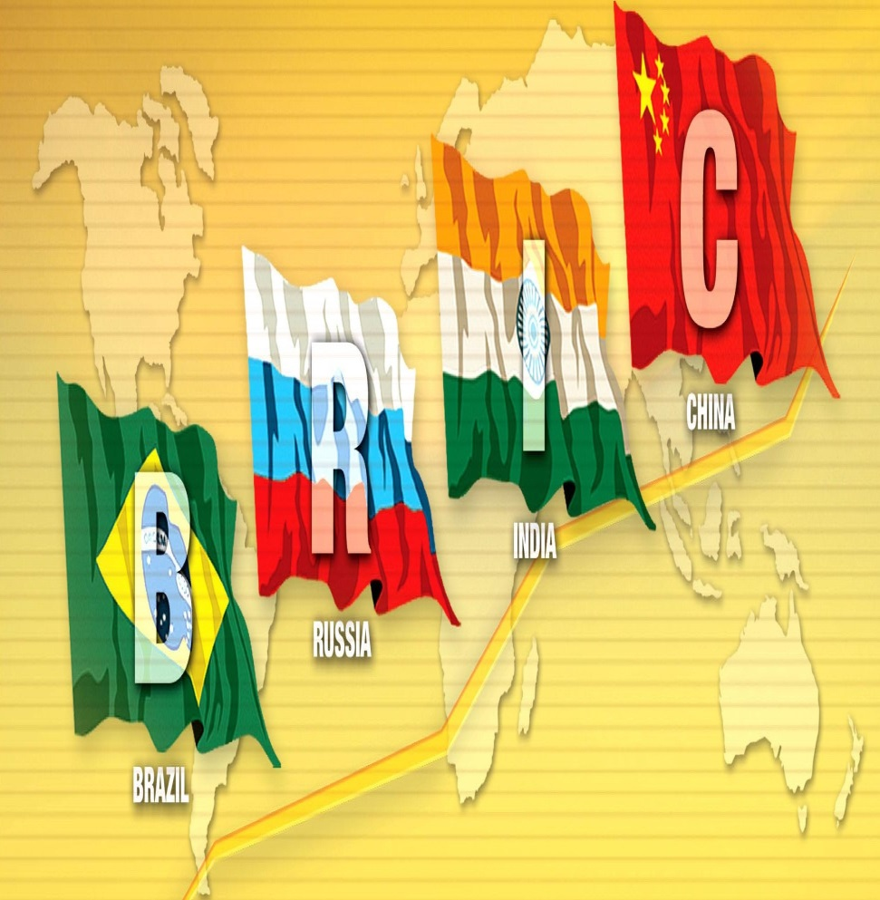
New Economic Ties
Goldman Sachs coined term BRIC for Brazil, Russia, India, China
Growing so fast that they make overtake richest economies by 2050.
Both China and Russia have authoritarian governments today.

Slide 9
Government and Politics in Russia
Russia in an Age of Democratization
Between 1945 and 1991 competition between two superpowers: Soviet Union and United States.
First president of Russian Federation was Boris Yeltsin who declared an end to the Soviet style regime.
Shock-therapy-Reforms that he directed pointed the country into new direction of democracy and free market.
Not very lucid president. Family and friends took over and established corrupt oligarchy.
Constitution written in 1993.
Vladimir Putin elected in 2000 and 2004 without serious conflict
Stepped down in 2008 as per Constitution, but stayed on as Prime Minister under Dmitri Medvedev.
Won re-election for president in 2012, now a 6 year term.

Slide 10
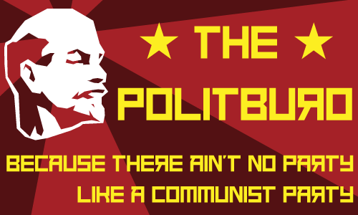
Sovereignty, Authority, and Power
For most of 20th century, power emanated from Politburo of the Communist Party.
Small group of men who climbed ranks of party through nomenklatura-ordered path from local soviets to commanding heights of leadership.
Left a new government in place with questionable legitimacy.

Slide 11
Sovereignty, Authority, and Power Legitimacy
Legitimacy is Russia difficult because change is so drastic and recent.
First legitimacy based on tsars, then dictatorship with democratic centralism. Stalinism entered into stint of totalitarianism.
Attempted to establish Constitution in 1993 provided strong president, but checked by Duma and elections.
Importance of duma-lower house of legislature that checks the president’s power.
Dates back to tsar of late 19th century.

Slide 12
Historical Influences on Political Traditions
Several legacies from Russian history have shaped modern political system:
Absolute, centralized rule-From beginning Russian tsars had absolute power from geography. Why? Also in communist party with unchallenged regimes. Some believe Vladmir Putin bring back this style of leadership.
Extensive cultural heterogeneity-Numerous invasions and rapidly expanded borders. Borders have almost been in a constant state of change.
Slavophile vs. Westernizer-”Slavophile” lover of Slavs vs. Westernizing brought about by Tsar Peter the Great in late 17th cent. and then increased by Catherine the Great.
Revolutions of 20th Cent-Tsars came to end in 1917 with Lenin’s Bolsheviks. Second revolution in 1991.

Slide 13
Sovereignty, Authority, and Power Political Culture
Russia’s political culture shaped by geographic setting, cultural orientation, and conflicting attitudes toward state.
Geographic setting-largest country in the world. Coldest country with many natural resources which have been recently developed. Not a great deal of access to water.
Eastern Orthodoxy-Cast lot with Constantinople and adopted Eastern Orthodox religion. Valued strong state over individualism. Statism as opposed to civil society in west or spheres of privacy free from control of state. Government then forbid its people to practice religion but government control remained.

Slide 14
Sovereignty, Authority, and Power Political Culture
Continued…
Equality of Result (not equality of opportunity)-Many Russians resent wealth differences. Not conducive for capitalism.
Skepticism about Power-Citizens are very hostile toward their leadership. Mihkail Gorbachev found this out when instituted glasnot. Putin has traditionally been highest favored leader.
Importance of Nationality-Tend to categorize others based on nationality. Admire Baltic people for “civility” and sophistication. Often anti-Muslim-Turkic people of Central Asia. Anti-semitism strong in tsarist Russia.

Slide 15
Political and Economic Change
In contrast with Britain, Russia has always had trouble with gradual and ordered change. Often has a resistance to change and tendency to resort to revolution.
History has been characterized by 3 distinct time periods
Long autocratic rule by tsars-ruled from 14th cent to 20th cent. Control with Romanov family from 17th cent onward. Transitions accompanied with brutality and assassinations.
20th cent rule by Communist Party-Began in 1917 with Lenin. Fell in 1991 when failed coup from inside gov. created chaos.
Abrupt regime change to democracy and free market-Boris Yeltsin put in western-style reforms in 1991.

Slide 16
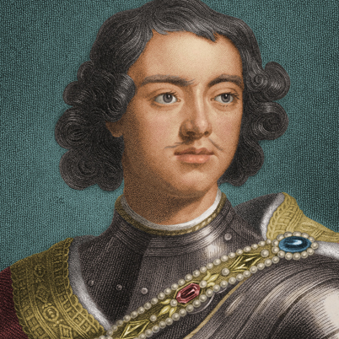
Political and Economic Change Tsarist Rule
First tars princes of Moscow who were rewarded by Mongol rulers for assistance with land and power.
Declared themselves head of Russian Orthodox Church.
Western Influence
Tsar Peter the Great introduced technology and culture to increase Russia’s influence.
Catherine the Great became an enlightened despot-who rules absolutely but with clear goals for the country.

Slide 17
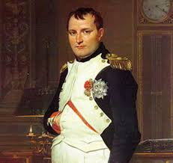
Political and Economic Change Tsarist Rule
Nineteenth Century Tsars
Napoleon’s invasion of 1812 brought Russia into contact with the West.

Slide 18
Political and Economic Change Revolution of 1917, Lenin, and Stalin
Most immediate cause of Revolution was ineffectiveness in fighting Russo-Japanese War and World War I.
Russian soldiers fighting without guns or shoes-had mass defections.

Slide 19
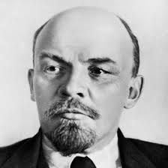
Political and Economic Change Revolution of 1917, Lenin, and Stalin
Lenin and the Bolsheviks
Not supposed to take place in Russia. Why?
Lenin in 1905 argued for democratic centralism- Took control of government in 1917.
1918 civil war between White Army (Russian Military Leaders) and Red Army (Lenin)
Created plan that allowed for private ownership under centralized leadership but died in 1924.

Slide 20
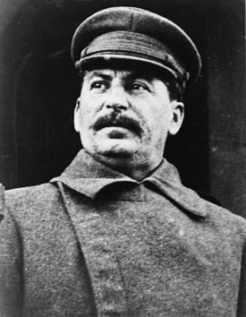
Stalinism
Allowed no other political parties than Communism.
Most top government officials belonged to Central Committee-300 party leaders that met twice per year.
Politburo-Above Central Committee-12 men whose decisions were carried out by government agencies.
Head of Politburo was general secretary or dictator of country

Slide 21
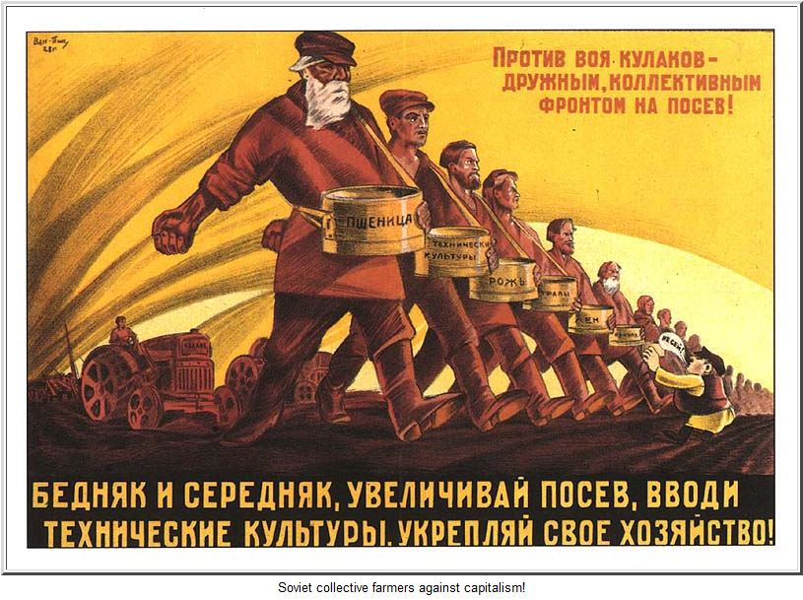
Political and Economic Change The Revolution of 1917, Lenin, Stalin
Collectivization and Industrialization
Made “collective farms” that were state run and supposedly more efficient. Meant to feed workers helping with industrialization.
Some Kulaks refused and forced to cities or labor camps. Many died.
Also set out 5 year plan for industrialization of oil, steel and electricity.
Stalinism-collectivization and industrialization through central planning with force and brutality.

Slide 22
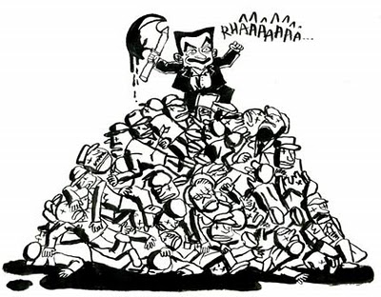
Stalin’s Foreign Policy
Focused on internal policies. Signed non-aggression pact with Germany in 1939 but then attacked.
Stalin’s Purges
Execution of millions of citizens including one million party members.

Slide 23
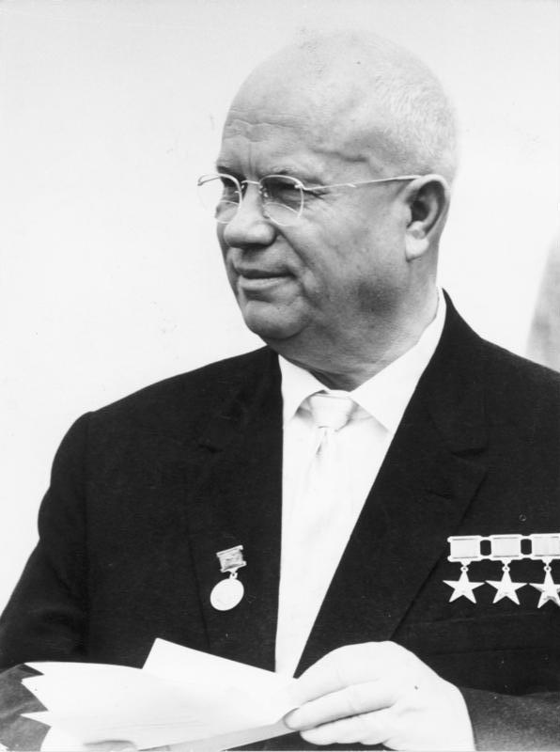
Political and Economic Change Reform under Khrushchev and Gorbachev
Nikita Khrushchev chosen to replace Stalin after death in 1953.
Worked toward deStalinization of loosening government censorship.
Criticized that reforms didn’t work and replaced by much more conservative Leonid Brezhnev.
Replaced by Gorbachev in 1985 who was much more westernized.

Slide 24
Political and Economic Change Reform under Khrushchev and Gorbachev
Gorbachev’s 3 Pronged Program
Glasnost
“openess”
After years of oppression, people were very hostile but West applauded.
Democratization
Wanted 1)a new Congress of People’s Deputies with elected representatives. 2) Postion of “president” that was selected by Congress.
Perestroika
Most radical and least successful reform. Gave economic powers held by government to private hands.

Slide 25
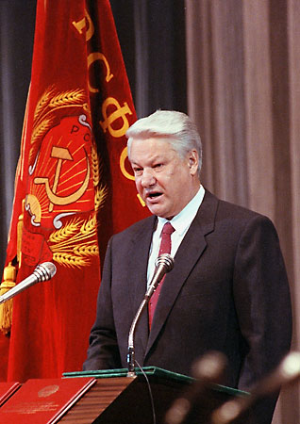
Political and Economic Change A Failed Coup and the Revolution of 1991
Conservatives in Politburo led a coup d’etat that tired to remove Gorbachev from office.
Failed but by December 1991 eleven republics declared independence which led to end of the union.
Then 15 republics went separate ways.
Boris Yeltsin emerged as president of Russian Federation.

Slide 26
Political and Economic Change Russian Federation: 1991 to Present
Yeltsin wanted a western-style democracy.
Constitution of 1993 created a three-branch government with president, prime minster, and lower legislative house called Duma and a Constitutional Court.
Yeltsin had illnesses, alcoholism, and erratic behavior.
Putin took over who at first supported Yeltsin but has proven much more conservative.

Slide 27
Citizens, Society, and the State
Cleavages
Nationality- 80% Russians but other nationalities lead to “federation” with autonomous regions. Chechnya is Muslim region that has fought for years for freedom.
Religion- Under tsar very Russian Orthodox, but then communists banned religion. Boris Yeltsin encouraged return to religion but many are still nonreligious. Largest amount of Muslims in European country excluding Turkey (Moscow, Caucasus, Bashkortostan and Tatarstan).
Social Class- established members of Communist party and non-members. New social classes with new market economy.
Rural/Urban Cleavages- Industrialization since Stalin led to large urban population- 73% in cities. City dwellers more educated and in touch with west.

Slide 28
Citizens, Society, and the State Beliefs and Attitudes
Marxism predicted demise of capitalist west, which supported idea that Russian government and way of life would prevail.
Stalinism- ideas shifted to pragmatic internal development toward absolutism and repression.

Slide 29
Beliefs and Attitudes
Has lead to great distrust and hostility toward government today.
Mistrust of government-alienation toward political system. Most do not trust officials to ensure democratic ideals that people support.
Statism-citizens still expect government to take active role in lives and protection. Have always been more as subjects than participants in society.
Economic Beliefs-most support market reforms but those who liked communism are less enthusiastic.
Westernization- Some parties emphasize nationalism and protection of interests while others want integration of Russia into world economy.
Some citizens are still nostalgic for the “good old days”

Slide 30
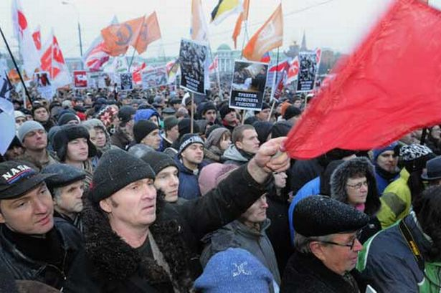
Citizens, Society, and the State Political Participation
Voting rate close to 100% during Soviet rule.
In 2008 had series of protests to criticize government’s economic policies and return to centralized economic policies.
Now it is higher than US but lower than Britain or France.

Slide 31
Citizens, Society, and the State Civil Societies
Participation in political activities low.
Most Russians don’t attend church on regular basis, belong to sports or recreational clubs or charitable organizations.
Only 1% belong to a political party but not necessarily disengaged from politics.
Civil society is growing in Russia.

Slide 32
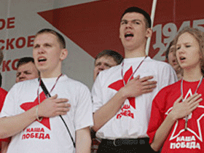
Citizens, Society, and the State Russian Youth Groups
Vladmir Putin as president created youth movements to support government.
Nashi-largest youth group to build loyal and patriotic young people and to defuse any youthful resistance that may have emerged in election of 2008.
Many staged demonstrations to support government.
May 2011- 50,000 protestors arguing corruption of government opponents, not government officials.

Slide 33
Political Institutions
Many different regime types throughout history but tradition is highly authoritarian.
Even though Soviet Union was highly centralized, it still maintained a federal government structure. Now has 89 regions, 21 who are ethnically non-Russian.
Putin cracked down on regional autonomy recently. Some measures are
Creation of super-districs-7 new federal districts to encompass Russia. Each district headed by presidential appointee.
Removal of governors- Can remove governor who refuses to subject local law to national constitution.
Appointment of governors-governors now nominated by president.
Changes in Federation Council- Upper legislature based on upper class traditions.
Elimination of single-member-district seats-Used to have half of 450 seats elected by single-member district but Putin made it all proportional representation.

Slide 34
Political Institutions Linkage Institutions
Linkage groups not strong in Russia. Interest groups don’t have solid footing since private organizations are weak.
All seats in Duma are elected by proportional representation.
Parties-Many revolve around particular leaders.
Leadership is still personalistic and parties weak and fluid.
United Russia- Support behind Putin. Hard to define except that it is pro-Putin.
Communist Party of Russian Federation- (CPRF)2nd strongest party. Not as reformist but emphasize centralized planning and nationalism. Intention to regain lost territories.
Liberal Democrats-Most controversial. Most controversial with Vladimir Zhirinovsky. Extreme national positions with racist and sexist opinions.
A Just Russia- Formed in 2006 with merger of Motherland People’s Patriotic Union and Party of Pensioners and Party of Life.
Patriots of Russia-”statists” and “patriots”-Opponents say it is set up by Kremlin.

Slide 35
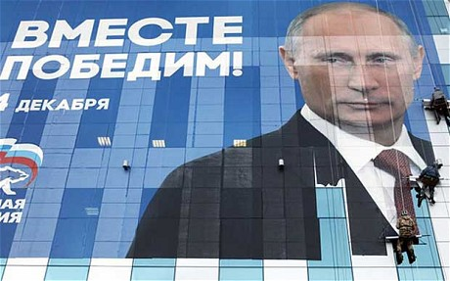
Political Institutions Linkage Institutions
Since 1993, ideological parties have faded in importance and have been replaced by parties of power-parties strongly sponsored by economic and political power-holders.
Like how United Russia is Putin’s party.

Slide 36
Political Institutuions Elections
Has three types of national votes.
Referendum- constitution allowed president to call for national referenda on important issues. Voted in favor of a new constitution. Chechnya had regional referendum in 2003 for Constitution which said Chechnya was “inseparable part” or Russia.
Duma Elections-Gone to polls 6 times to elect Duma members now proportional representation due to Putin. Have 450 seats and must get at least 7% (raised from 5) of total vote to get any seats.
Presidential Elections- Follow a 2-round model that Duma has if president does not receive of 50% of vote on first try.

Slide 37
Political Institutions Interest Groups
Interest groups were only allowed in Soviet Union under state corporatism-controlled by the government.
Oligarch- State owned industries that were snatched up and made people wealthy. Now have significant control. Best known was Boris Berezovsky (he and 6 other entrepreneurs had over ½ of Russia’s GNP)Khodorvskvy arrested in 2003 from Putin as warning to other oligarchs.
State corporatism-Under Putin state determines which groups have input in policy making. Has vast state-owned companies in automobile and aircraft manufacturing, shipbuilding, etc… If a company becomes too rich state cites legal infractions. (Insider Beneficiaries)
The Russian Mafia-controls underworld crime but also local businesses, natural resources, and banks. Murdered bankers, journalists, businessmen, and Duma members.
Russian Media-Pravda only newspaper under Soviet Union. Under Putin tightened control of press. Very clear message not to criticize the government.

Slide 38
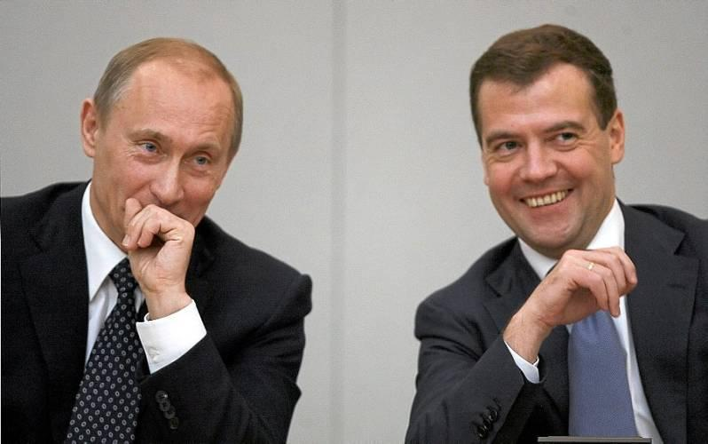
Institutions of Government
Structure of government put in place by the Constitution of 1993.
Has both presidential and parliamentary systems which is meant to allow for strong presidency which democratic checks on executive power. (semi-presidential)

Slide 39
Institutions of Government The President and the Prime Minister
Executive branch separates the head of state (the president) from the head of government (the prime minister).
Under Putin, the president came to dominate the prime minister.
Running for president
Since 2012 voters directly elect president for six year term. Limit of two consecutive terms.
President has power to
Appoint prime minister and cabinet-Duma must approve but if they reject three times president can resolve Duma.
Issue Decrees that have the force of law- Duma has no real power to censure the cabinet except to reject prime minister.
Dissolve the Duma- Yeltsin ordered Russian Parliament dissolved but they refused to leave “white house” so he fired on them.
No vice-president, so if president dies before term is up, the prime minister becomes acting president.

Slide 40
Institutions of Government. Bicameral Legislature
Legislature so far is very weak check on executive power.
The Lower House-Duma 450 deputies all elected by proportional representation. Passes bills, approves budget, and confirms president’s political appointments. Very limited since the president may rule by decree.
The Upper House- The Federation Council- two members from each of 89 federal administrative unites. One selected by governor of each region and another by regional legislature. Represents regions. Power to delay legislation. May change boundaries, ratify use of armed forces, and appoint/remove judges (Have not been used yet.)

Slide 41
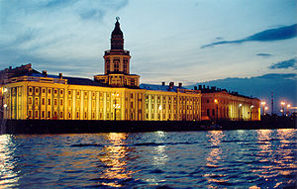
Judiciary and Rule of Law
Constitution of 1993 created a Constitutional Court independent from executive branch.
19 members appointed by the president and confirmed by Federation Council.
Supposed to make sure that all laws and decrees are constitutional but Putin proposed to move them out of Moscow and to St. Petersburg.
Also has supreme court to serve as final court of appeal in criminal and civil cases.
Independence from executive branch is questioned.
Rule of law questioned because survey found that at least ½ of country involved in corruption in daily life.

Slide 42
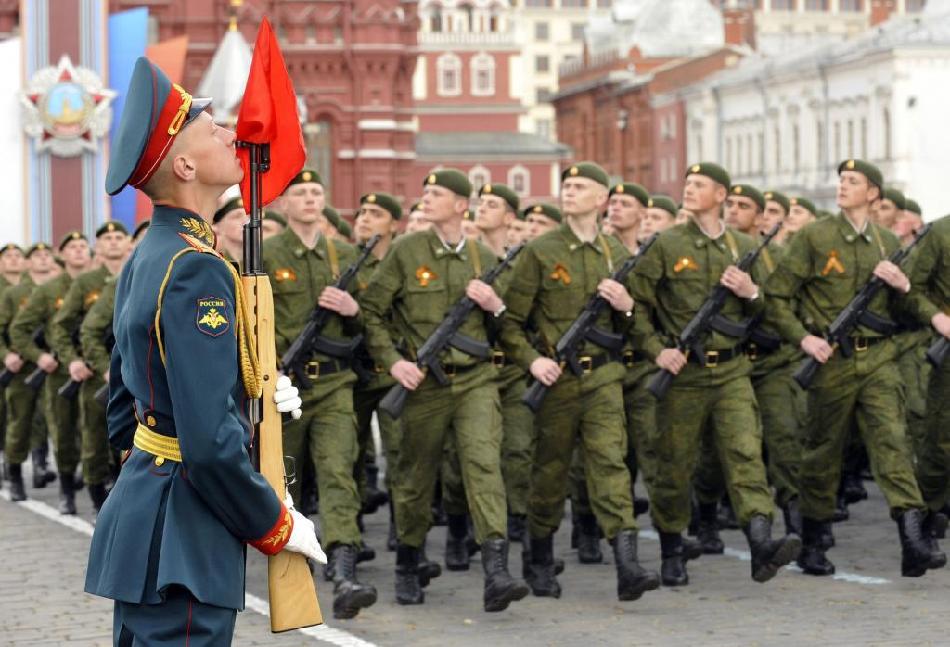
The Military
Soviet government put military ahead of almost everything else.
Did not appear to be a significant threat in the 1990s.
Military spending and power has increased significantly in recent years and Georgia of 2008 was successful.

Slide 43
Public Policy and Current Issues
The Economy-Biggest problem in Soviet Union at heart of demise was economic problems. How much centralized planning? Today improving, fueled by huge oil and gas reserves. Priority to diversify the economy.
Foreign Policy- Dominance broken in 1991.
Relations with near abroad- Confederation of Independent States unites fifteen former republics. Most recently invasion of Georgia.
Relations with West- Loss of superpower status from Cold War era. US feels that a strong Russia is important. Trying to become a part of the WTO.

Slide 44
Public Policy and Current Issues
Terrorism- A number of terrorist attacks in recent years. Beslan school siege in 2004. 360 people died. Many attacks in Caucasus.
Population Issues- Dramatic drop in overall population recently. Low birthrate and poor health habits. Goes back to Soviet Era where abortion was seen as a type of birth control. Encouraging people who live abroad to return home.

Slide 45
Public Policy and Current Issues
Re-centralization of Power in the Kremlin?- Some believe that Putin is trying to give power back to Kremlin rather than counter terrorism. Now controls major television stations. Dmitri Medvedev hand-picked by Putin.
Development of a Civil Society- Acceptance of two areas of life
Public one defined by the government
Private one in which people free to make individual choices.
Heavily influenced by statism.
Is it really true that it is “human nature” to value individual freedom above equality?

