Slide 1
Supranationalism and the European Union
The smallest section!!!! ☺

Slide 2
Introduction
One major trend in Britain is devolution-the process of decentralizing the unitary state to share policymaking power with regional governments.
Yet have countertrend of integration-process that encourages states to pool sovereignty in order to gain political, economic, and social clout.
This supranational trend is in the European Union.

Slide 3
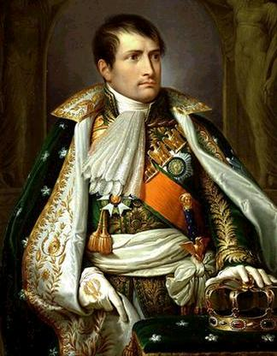
Supranationalism
Concert of Europe
Formed to restore balance after Bonaparte
Voluntary agreement-did not prevent wars
League of Nations
Started after WWI lasted until 1939
United Nations
Formed in 1945
Agreement between Franklin Roosevelt and Winston Churchill

Slide 4
The United Nations
United Nations started with 49 countries in 1945.
Changes idea of sovereignty with collective membership-not just individual nation-states.
Important power is that members can vote to establish a peacekeeping force in a “hotspot” and request states to give military forces.

Slide 5
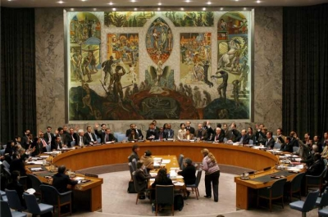
The United Nations
Security Council makes this decision and is made up of
United States
Russia
France
China
Britain
May veto a peace keeping action.
Caused gridlock during Cold War.
UN forces supposed to remain neutral-restrictions on weapons.
Forum where states can meet and vote on issues without war.

Slide 6
Worldwide Supranational Organizations
World Trade Organization
Agreed to rules of world trade-established in 1995
Implements new trade agreements and makes sure everyone follows rules.
Most countries belong to WTO.
Forum for settling disputes.
Acceptance different for each country depending on development.
China denied for many years.
The World Bank
Est. in 1944 to help countries rebuild.
Now focus on loaning money to low and middle-income countries at low interest rate.
Goal is to eliminate poverty and support economic development.
Supports health initiatives and business.
Also tries to reduce greenhouse gases.
Includes 186 countries but economically powerful countries choose leaders.

Slide 7
Regional Organizations
North Atlantic Treaty Organization
Began in late 1940s with 14 Euro countries, US, Canada.
Warsaw Pact
1955 with USSR and six eastern European countries
Bipolar balance of Europe.
NATO expanded after USSR to include former countries.
Arab League
Promote interest of countries in Middle East.
Organization of African Unity
Elimination of white-minority governments.

Slide 8
The European Union
Started after WWII in 1949 with economic intent.
Council of Europe in 1949
European Economic Community in 1957.
Elimination of tariffs
The European Community of 1965
Peaceful atomic energy
Got boost from breakup of Soviet European dominance in late 1980s.
The European Union of 1991
Created in 1991 under Maastricht Treaty.
Common currency

Slide 9
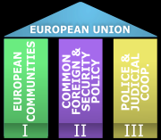
The European Union
European Union established three pillars or spheres of authority
Single currency and creation of European Central Bank
Justice and home affairs (border crossing, governing asylum)
Common foreign and security policy, common defense policy.

Slide 10
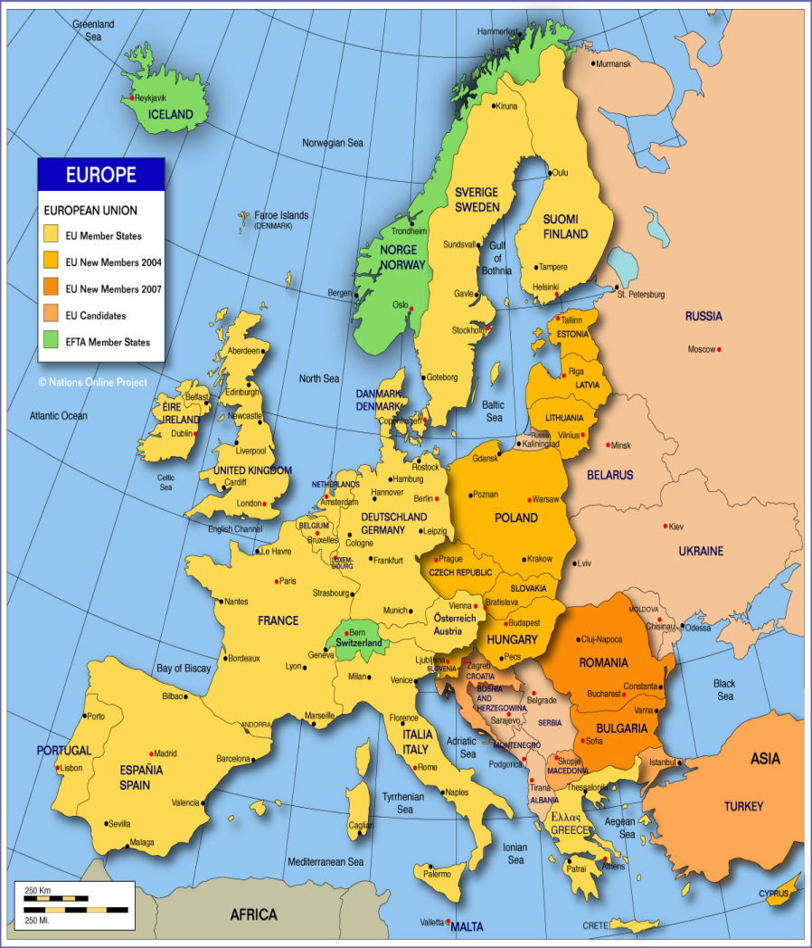
The European Union
Membership
Had 27 countries as of 2011
Began with 6 countries in 1957. (Bel, Fr, Ital, Lux, Neth)
Several countries under consideration (Turk, Mace, Croatia)
Turkey controversial-why?
Has brought enlargement fatigue
Like what?
To be accepted you must
Have stable and functioning democratic regime
A market-oriented economy
Willingness to accept all EU laws and regulations.

Slide 11
EU Organization
Has 4 major bodies
The Commission
27-1 from each state
Supported by bureaucracy of several thousand civil servants.
Each takes responsibility for particular area of policy and heads department called Directorate General.
President Jose Manuel Durao Barrosos of Portugal.
Home governments nominate them, but swear an oath not to take direction from national govs.
Big responsibility is to create and implement new programs.
The Council of Ministers
Demonstrates continuing power of states
Has foreign ministers, finance ministers, president of France, prime ministers of other members.
Heads of state meet every six months in European Council.
Lisbon Treaty made president of council permanent instead of rotation
May initiate legislation but don’t become policy until passed by commission.

Slide 12
EU Organization
The European Parliament
Not big legislative power
Directly elected by people of country-so some independence from government-vote every 5 years.
May propose amendments or reject proposals from council-but council may override with unanimous vote.
The European Court of Justice
Supreme court of EU
Has judicial review
Could take away some state sovereignty.
Ruled Britain not allowed to charge less insurance for women drivers.
One judge nominated from each state.

Slide 13
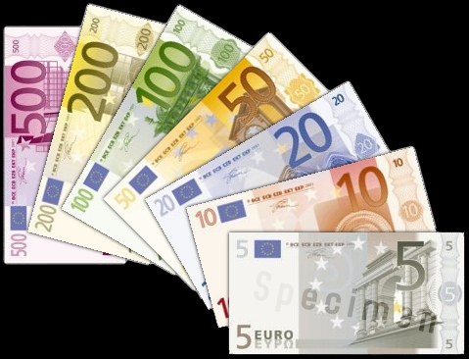
Policymaking Power
The areas of active policy making are…
Creating and maintaining a single internal market
Gotten rid of trade barriers
License accepted most countries.
Union of monetary policy
Most states use Euro except Britain and Sweden.
2008 wanted Europe wide stimulus.
New central bank-European Monetary Union

Slide 14
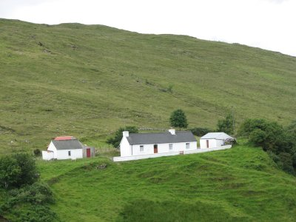
Policymaking Power
Common Agriculture Policy
Large amount of money going to agriculture
Modernize inefficient farms
Farm subsidies
Very expensive and hasn’t yet improved farms.
Common Defense
Much less developed than economic ideas.
Crisis management tasks core for common security.
60,000 troops in 60 days for at least 1 year.
No European army-up to the member states.

Slide 15
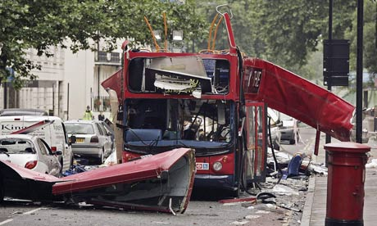
Policymaking Power
Justice and Home Affairs
Treaty of Amsterdam-free movement (visas, asylum, immigration)
Combination of police forces to combat crime.
Terrorism
Since 2004 meetings between US and EU on border and transportation authority.

Slide 16
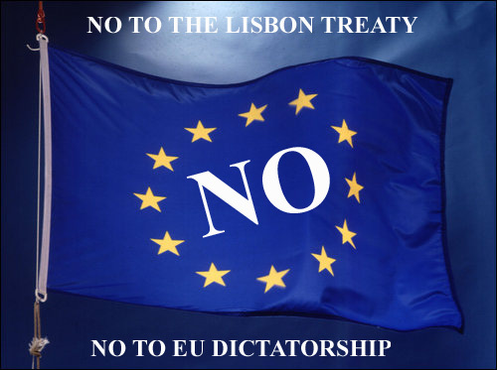
The European Constitution of Lisbon Treaty
Attempted constitution in 2004 but never ratified.
Tried to streamline decision-making due to growth.
In effort to salvage goals, signed Lisbon treaty. Consolidated previous treaties.

Slide 17
Some Important Provisions
A Strengthening Role for the European Parliament
Gives them equal footing with European Council
More say in EU budget
A Greater involvement of national parliaments
National parliaments have more opportunities to be involved
EU only acts when results can be better achieved through EU.
Enhance democracy and legitimacy

Slide 18
Some important Provisions
Clarification of the relationship between member states and the EU
What the EU is responsible for and what national governments are responsible for.
Withdrawal from Union
Possibility to withdraw from EU is recognized
For the first time.
Introduction of Charter of Fundamental Rights
Individual, economic, and social rights.
Creation of Permanent President of EU
Before treaty signed it rotated every 6 months.
Lisbon treaty made it a permanent and full time 2 ½ year term of office. Renewable once.

Slide 19
Economic Issues
Differences in members who want economic liberalism vs. protection of national economic interests.
Sovereign debt crisis-near collapse of Greek economy.
Not surprising since failed to join euro area in 99 because did not meet fiscal criteria. Probably should also not have been let in in 2001.
Also rescue packages in Ireland and Portugal
Bailouts strongly controversial-largely opposed in Greece.
Economic structural adjustment means that part of debt forgiven.
Underperforming American economies.

