Slide 1
Alexander the Great

Slide 2
Objectives
Explain the conquest of Greece by Macedonia King Philip II.
Summarize Alexander's the Great conquests and their impact on future cultures

Slide 3
Vocabulary
King Philip II:
Macedonia:
Phalanx:
Alexander the Great:
Thebes Revolt:
Alexandria:

Slide 4
Vocabulary

Slide 5
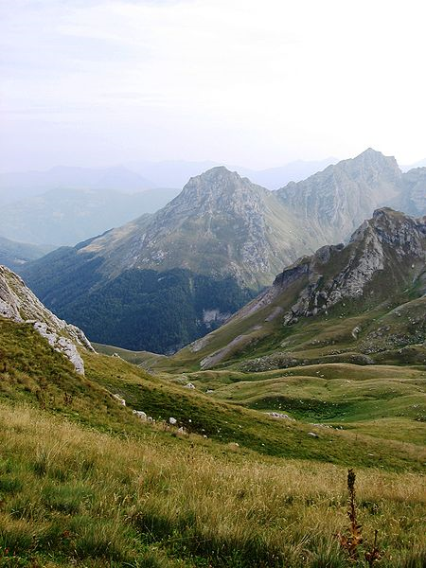
Macedonia
Kingdom located North of Greece

Slide 6
King Philip II
359 b.c crowned King at 23
Brilliant General
Conquered Greece/end of Greek Liberty
Wanted to invade Persia
Assassinated

Slide 7
Phalanx
Professional Army
16 men across and 16 men deep each armed with 18 foot pike used to break enemy lines
Cavalry then used to crush opponent

Slide 8
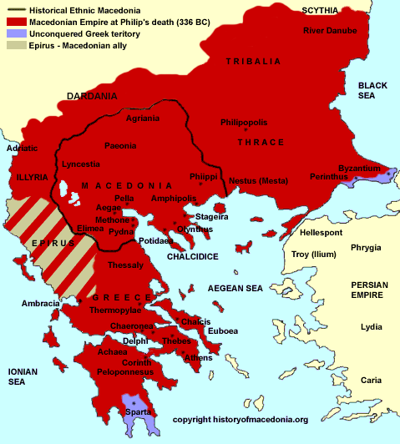
King Phillip II

Slide 9
Alexander the Great
Father was Philip II
20 years old crowned King
Strong military background
Aristotle was his private teacher

Slide 10
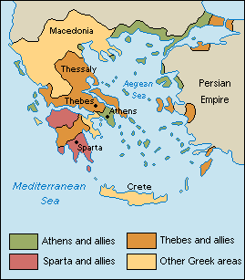
Alexander the Great
Thebes Revolt
Allied with King Phillip II
Rebelled under Alexander
Destroyed City
Proved Alexander’s military leadership

Slide 11
Alexander the Great
Invasion of Persia
334 b.c. 35,000 soldiers into Persia
King Darius II retreated
332 b.c. Alexander took Egypt from Persia rule
Founded city Alexandria Egypt
Alexander ruled the Persia Empire

Slide 12
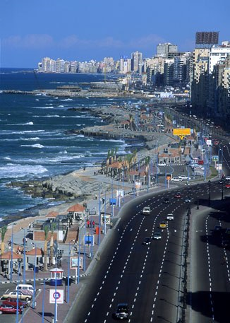
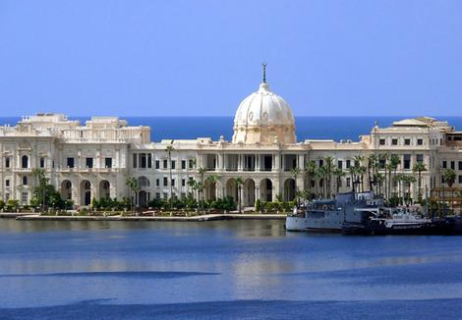
Alexandria Egypt

Slide 13
Alexander the Great
Hydaspes River (India)
326 b.c. battle between Indian Army and Alexander
Alexander won the battle
Troops ready to go home
11 years and 11,000 miles

Slide 15
Alexander the Great
323 b.c. Alexander returned to Babylon
Wanted to organize his empire
Ill with fever and died a few days at the age of 32 without naming an heir

Slide 16
Alexander’s legacy
Alexander’s empire largest world had ever seen
Cultural Legacy called Hellenistic

Slide 17
Questions /Quiz

